Slide 1
When Students
Write the Syllabus
teaching the unclass // now, with data!

Slide 2
How to create a more realistic representation of complex, real-world projects in the classroom?

Slide 3
How to emulate the ongoing training or “lifetime learning” that we all experience on a project-by-project basis?

Slide 4
Can we help students identify
the right questions
instead of the answers?

Slide 5
Help me help you.

Slide 6
Help you help you.

Slide 7
Motivation theory:
Choice.
Autonomy.
Relevance.

Slide 8


Slide 9
Unclass model:
Identify a goal.
Figure out how to get there.

Slide 10
Scary stuff:
Uncertainty.
Ambiguity.
Trial and error.
Lost work and time.

Slide 11
Scary stuff:
What we live every day.

Slide 12
The logistics:
Diverse teams.
Opt-in workshops.
Group deadlines.

Slide 13


D
D
D
D

Slide 14


Slide 15


Slide 16
Workshops:
Finding data, data scraping, cleaning data, rules & regulations, FOIA, R, JS, D3, case studies, design, user testing, goal-setting, the case against circles…

Slide 17
Unclass model:
Bake in critical thinking,
peer-to-peer learning.

Slide 18
Unclass model:
More diversity = more better.

Slide 19
Unclass model:
All levels welcome.

Slide 20
Unclass model:
Framing: This is a class about process, not about outcome.

Slide 21
Unclass succeses:
…but the outcomes are far better.

Slide 22
Testing:
Spring 2013 (undergrad)
Fall 2014 (grad)
Spring 2014 (undergrad)

Slide 23
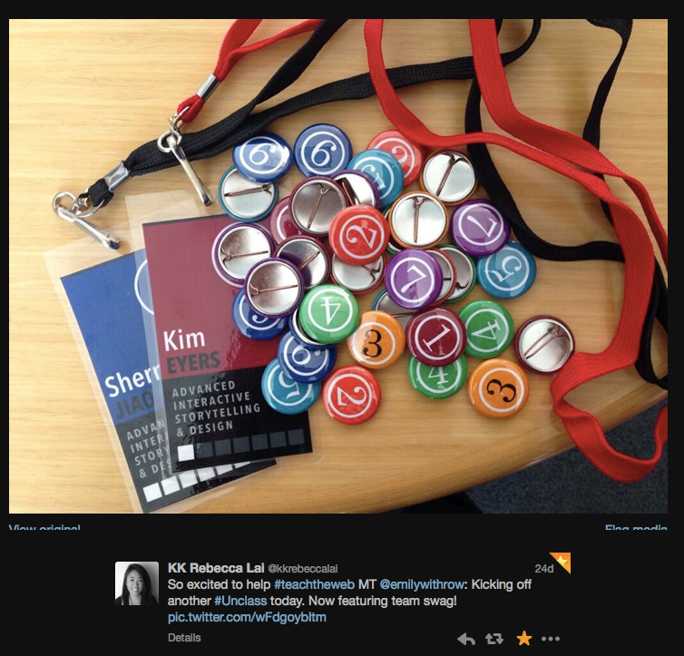
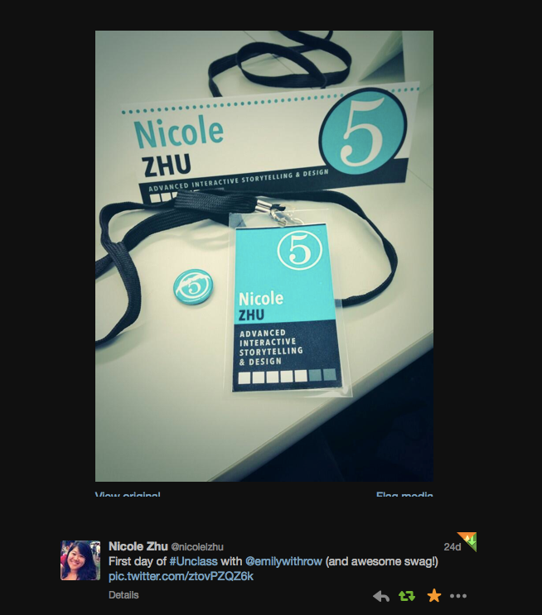
spring 2014
opening day

Slide 24
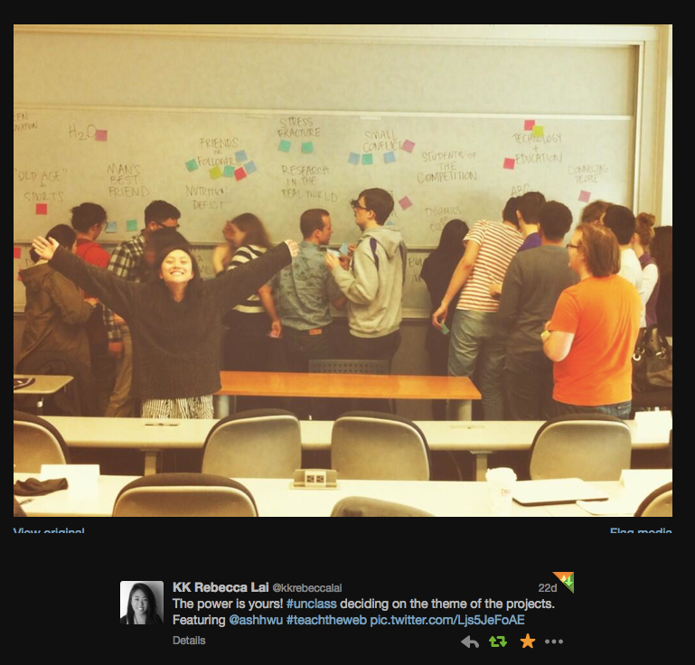
spring 2014
opening day

Slide 25
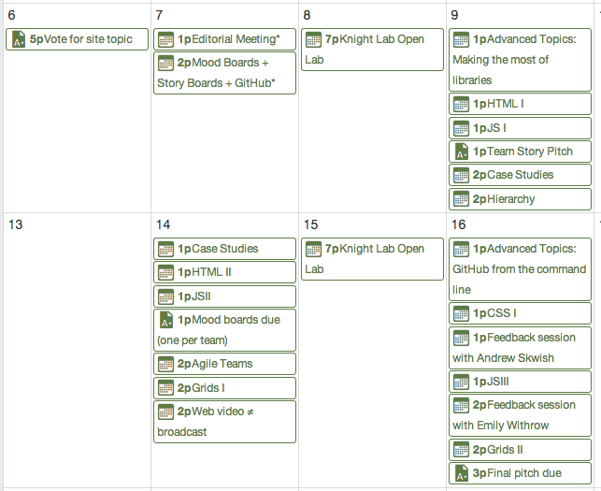
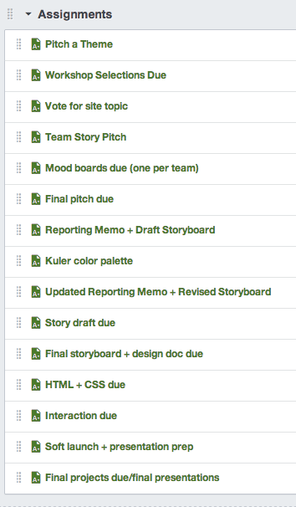
Problems:
Many moving parts.

Slide 26
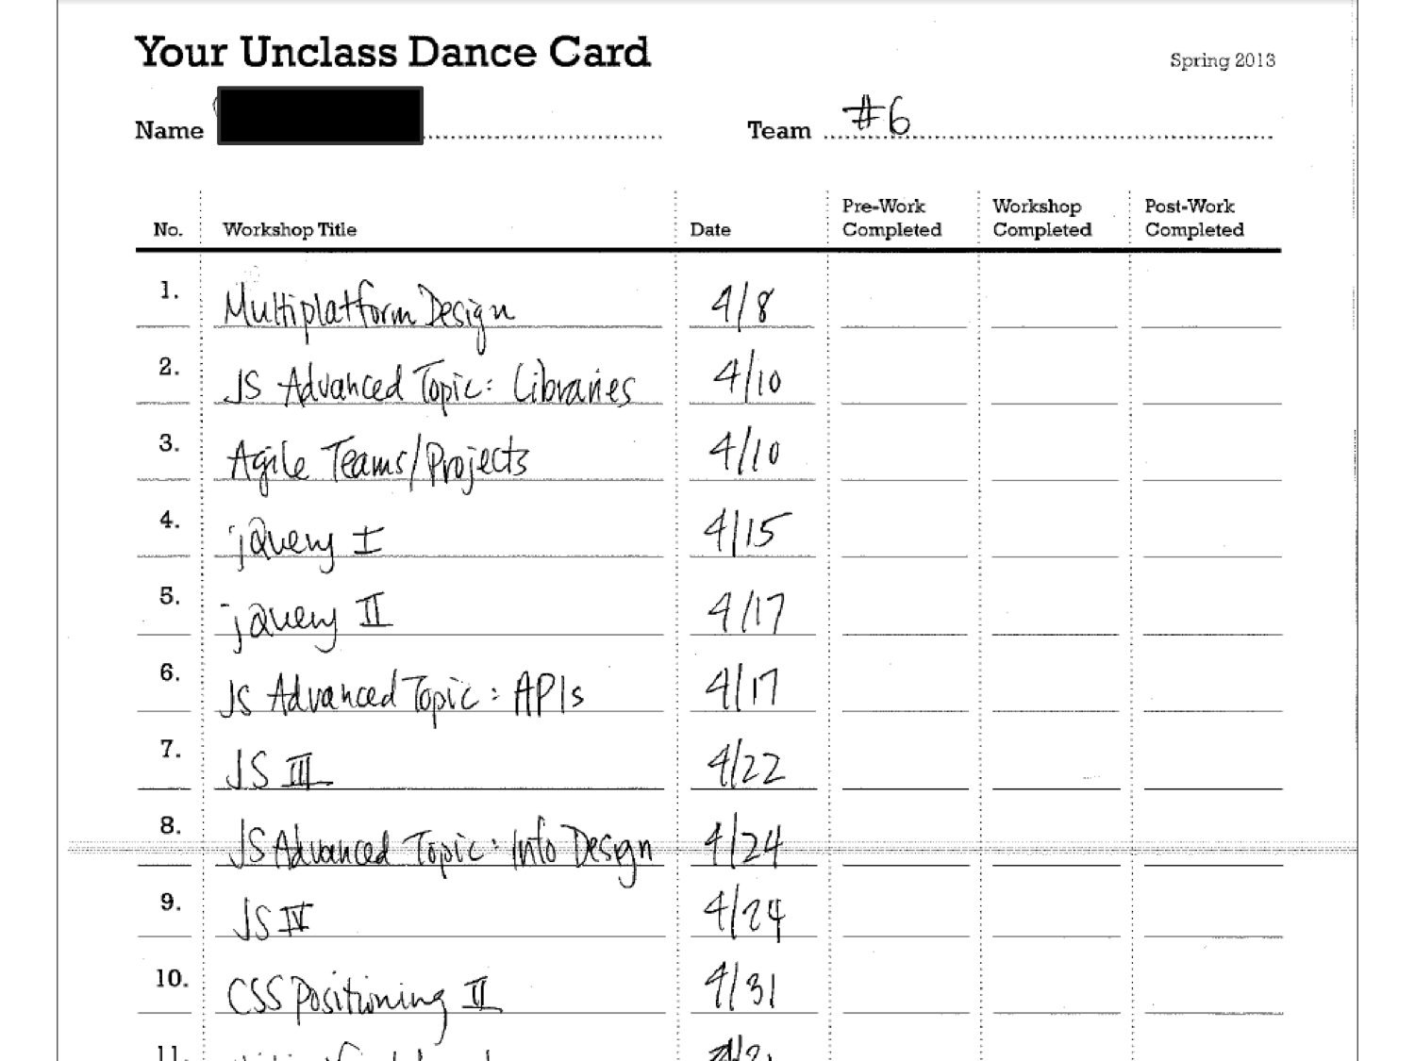
individual learning plans
preliminary sketches

Slide 27
Successes:
Tailored to student need.
Experts teaching expertise.
Flexibility.
Student-driven.
Peer-to-peer learning.
Final projects.

Slide 28
THANKS FOR LISTENING
Be in touch:
Emily Withrow
Assistant Professor, Medill
Northwestern University

